Slide 1
Forest Fire Area Prediction

Slide 2
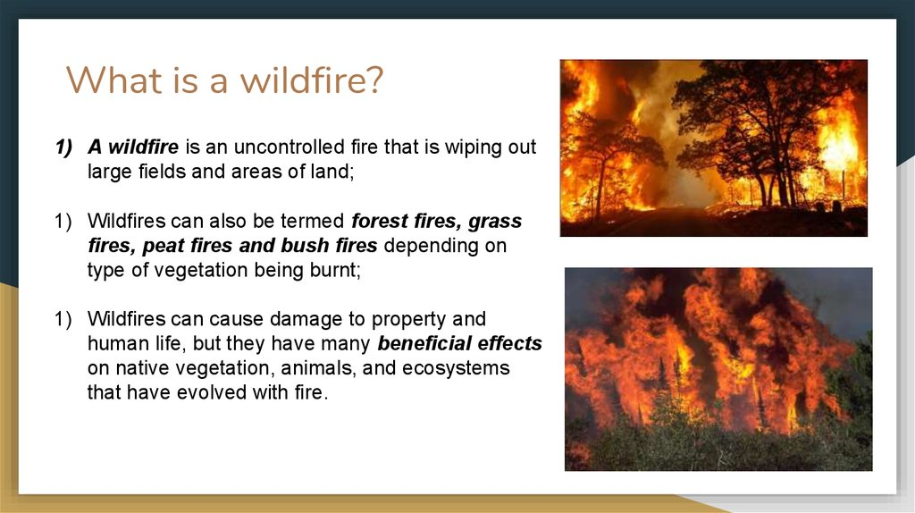

Slide 3
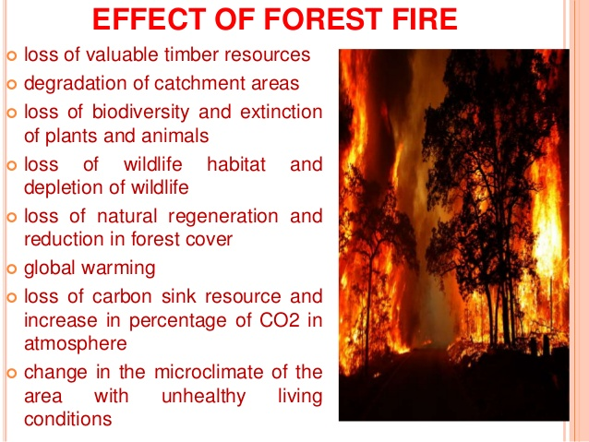

Slide 5
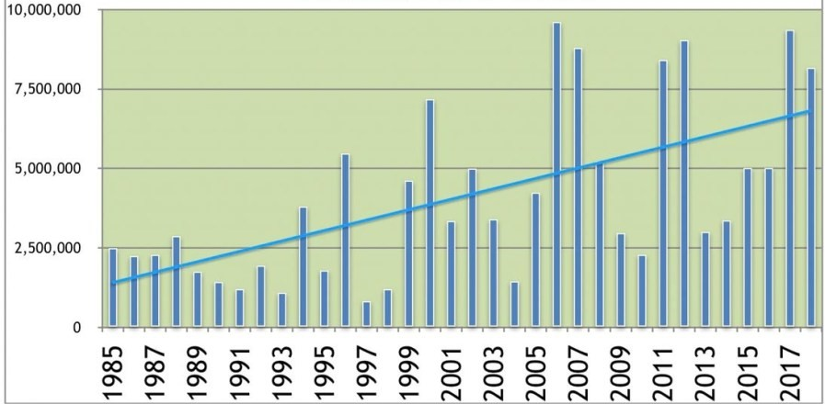
The burned area of forest due to forest fires

Slide 6
Procedure
To Reduce the Damage due to forest fires We can use the machine learning Techniques
There are two ways in machine learning they are supervised and unsupervised learning
Now we are going to use supervised Machine Learning
In that we are using Decision Tree Regression Algorithm to solve this problem
This is very helpful for fire fighters
This can be used by the forest authorities to predict the amount of area which is going to burn

Slide 7
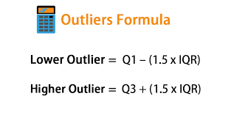
Correlation is a measure of how strongly one variable depends on another. Consider a hypothetical dataset containing information about professionals in the software industry. Correlation can be an important tool for feature engineering in building machine learning models.
Outliers are extreme values that deviate from other observations on data , they may indicate a variability in a measurement, experimental errors or a novelty. In other words, an outlier is an observation that diverges from an overall pattern on a sample.
These formulae are used to detect the outliers

Slide 8
Detecting And Replacing Outliers
We detect outliers for the variables and replace them with the median of their respective columns using the following code snippet.
Median=df.x.median()
df['X']=df['X'].mask((df['X']<maxvalue),median)

Slide 9
Decision Tree
Regression
Classification
Regression trees are needed when the response variable is numeric or continuous. For example, the predicted price of a consumer good. Thus regression trees are applicable for prediction type of problems as opposed to classification.
In a standard classification tree, the idea is to split the dataset based on homogeneity of data. Lets say for example we have two variables: age and weight that predict if a person is going to sign up for a gym membership or not. In our training data if it showed that 90% of the people who are older than 40 signed up, we split the data here and age becomes a top node in the tree. We can almost say that this split has made the data "90% pure". Rigorous measures of impurity, based on computing proportion of the data that belong to a class, such as entropy or Gini index are used to quantify the homogeneity in Classification trees.
Classification trees, as the name implies are used to separate the dataset into classes belonging to the response variable. Usually the response variable has two classes: Yes or No (1 or 0).
n a regression tree the idea is this: since the target variable does not have classes, we fit a regression model to the target variable using each of the independent variables. Then for each independent variable, the data is split at several split points. At each split point, the "error" between the predicted value and the actual values is squared to get a "Sum of Squared Errors (SSE)". The split point errors across the variables are compared and the variable/point yielding the lowest SSE is chosen as the root node/split point. This process is recursively continued.

Slide 10
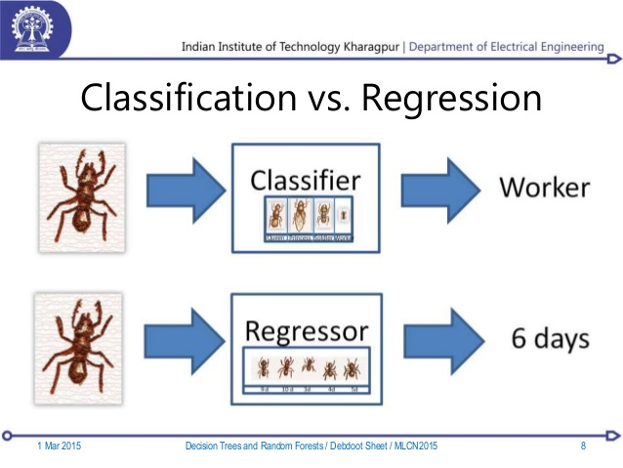

Slide 11
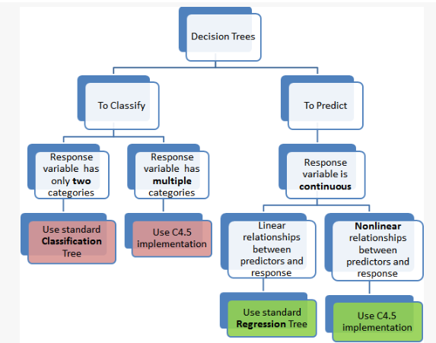

Slide 12
Formula To Find The Accuracy
print('r^2',metrics.r2_score(y_test,y_pred))
Accuracy obtained is :r^2 0.9999741805536381

Slide 13
Conclusion
Here we have tried to obtain a solution to predict forest fire area using the decision tree regression algorithm
This is helpful for reducing the loss of natural resources
This can be helpful to reduce the emission of green house gases by prediciting the area which is going to be and the amount of area going to be burned
This is helpful to people who are nearer to the forest areas can be evacuated before hand

Slide 14
